Slide 1

Monte Carlo Dropout Techniques in Preference-Based Deep Learning for Extractive Text Summarisation
James Stephenson

Slide 2
Contents
Project Aims
Key concepts
Proposed method
Results
Evaluation
Future work

Slide 3
Problem
Problem: People want different things from a summary. Some people want statistics, some people want quote etc.
Current preference learning solutions use Bayesian optimisation techniques to adapt summary rankings to a user’s preference.
However, these techniques fail to differentiate between aleatoric and epistemic uncertainty
We want to leverage Bayesian deep learning techniques to create a framework that adapts its summary suggestions to a user’s preference.

Slide 4
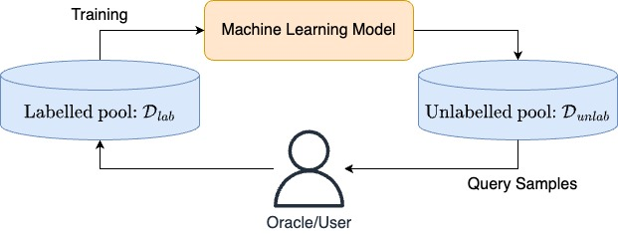
Active Learning
Active learning is a training method that incorporates an oracle/user to label data points when the quantity of unlabelled data is large.

Slide 5
How do we determine which sample to query?
We can use acquisition functions to evaluate which are the optimal candidates to query the user with.
Expected improvement is a Bayesian optimisation acquisition function that Simpson et al. found to be highly effective in similar frameworks.
This acquisition function finds the candidates which are expected to provide the biggest improvement to the current best candidate.

Slide 6
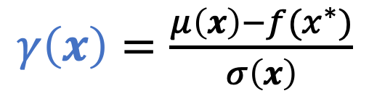
Expected Improvement
$$α_{EI}\left(x\right)= σ\left(x\right)∙\left[γ\left(x\right)Φ\left(γ\left(x\right)\right)+ φ(γ\left(x\right))\right]$$
$γ\left(x\right)=\frac{μ\left(x\right)−f(x^{∗})}{σ\left(x\right)}$
The expected improvement is directly correlated to the model’s confidence in a candidate.
Expected improvement focusses on exploitation of good candidates.
Caution! It’s known to over-exploit in some instances.

Slide 7
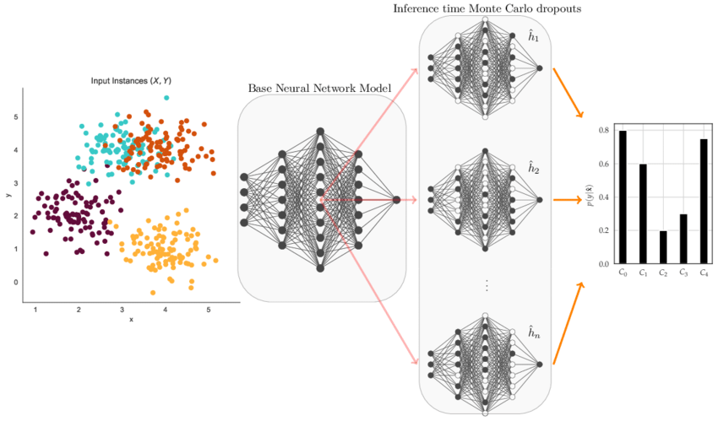
Monte Carlo Dropout (MCD)
MCD is a method of measuring uncertainty in a deep learner, by activating dropout during inference to generate a distribution of predictions.

Slide 8
Monte Carlo Dropout (MCD)

Slide 9
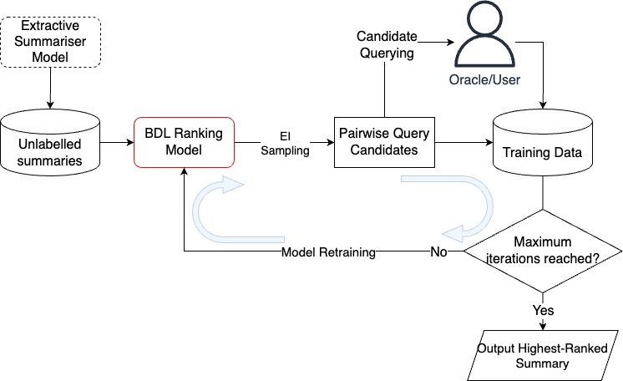
Proposed Method
Replace the ranking model in the preference learning framework from Simpson et al. with a Bayesian deep learning framework.

Slide 10
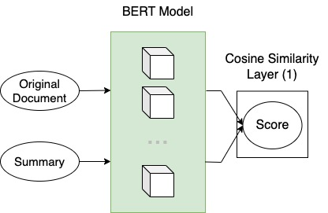
Model Candidate 1
Implement MCD within the encoding stage of the model to directly capture confidence in the model.
Fine tune the BERT model weights to adjust to user preference.
Notes:
We then compare the embeddings of the original document and the summary using cosine similarity to get a similarity score as our candidate utility.

Slide 11
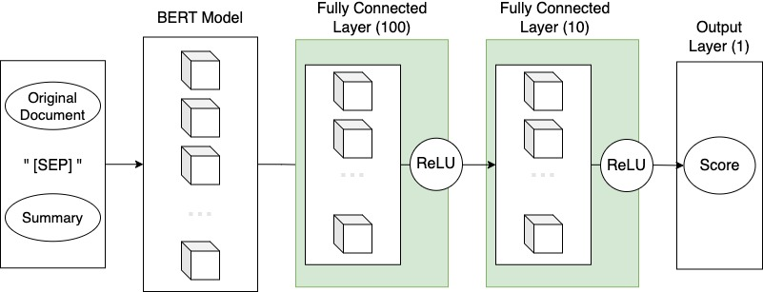
Model Candidate 2
Notes:
We added two layers to the encoder model and implemented MCD within these layers. The goal was to separate contextual understanding of the candidate and the user preference into two sections.
The weights of the additional layers were then adjusted in training to reflect the user preferences.
The output was a single-value preference score.

Slide 12
Model 1 Implementation
When training, we found that the weights exploded when the optimisation step was taken.
To combat this, we implemented gradient clipping and reduced the learning rate by 100x.
Neither of these approaches had any effect and resulted in no experimental results for this model.

Slide 13
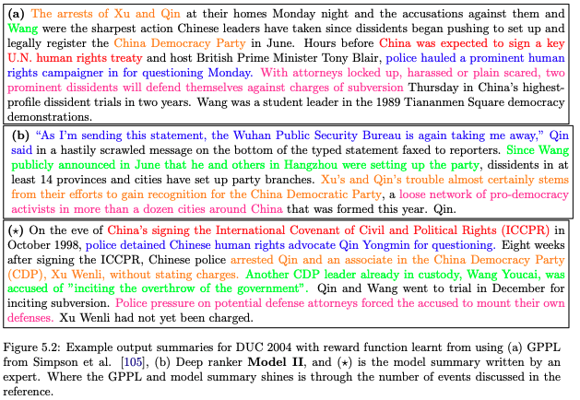
Case Study
We see the output summary for our candidate model finds value in including quotes.
However, fails to include one of the key topics that the model summary includes.

Slide 14
Model Performance
Our candidate fails to outperform the current ranking model across all datasets.
Further analysis has highlighted reasons for this performance difference:
Weak Preference Learning
Poor Text Processing & Embedding
TABLE

Slide 15
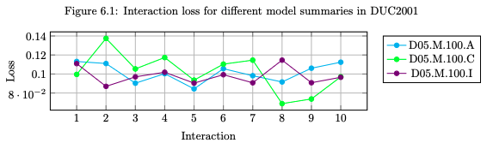
Preference Learning
The plot does not show any substantial reduction in loss from training.
This suggests there is little preference learning within this model which will have hindered the performance scores.

Slide 16
Input Processing
Weak text processing of the candidate summaries and original documents will be a cause of the model failing to effectively capture how good the candidate summary is.
It is important that the same pre-processing techniques are performed for all text inputs, so any comparison is done on the same type of input. i.e. SUMMARY and summary will be encoded in different ways.
Future studies would consider running all inputs through Pytorch DataLoader and Datasets to help with this.

Slide 17
Future Work
Improved input processing
Since original documents are much larger than the candidate summaries, these dominate the embeddings leading to weak comparisons.
Using Compressing Transformers or alternative BERT models such as SciBERT will help handle long sequences.
Ranking Architecture
Pre-trained models that are fine tuned to this task will lead to embeddings that better capture the candidates.
Changing the structure of the additional layers to help learn more complex preference patterns would be of value to explore.
Optimisation
Exploring parallel processing within sampling and scoring will help the interaction time which is currently very weak.
Also developing the tuning experimentations to move away from a sequential training will highlight any hyperparameter combinations that future boost performance.
Notes:
Three areas for future development.

